Slide 1
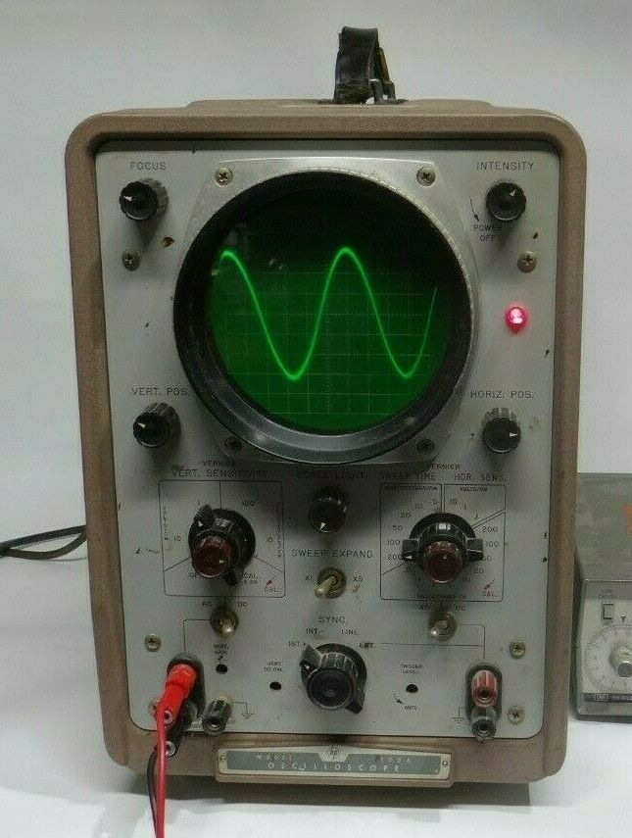
Intermediate Oscilloscope Use and Understanding
Feb-2022

Slide 2
Agenda
1. Sampling/quantization
2. Basic and advanced triggering
3. Probing Technique
4. Bandwidth and Sample Rates

Slide 3
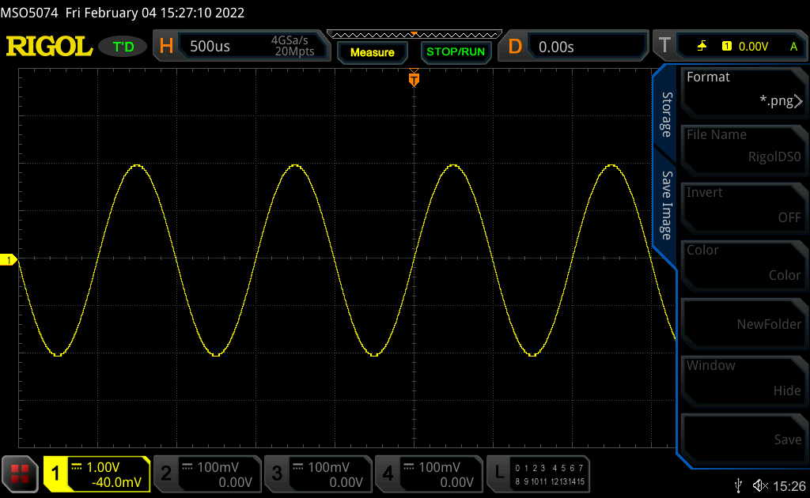
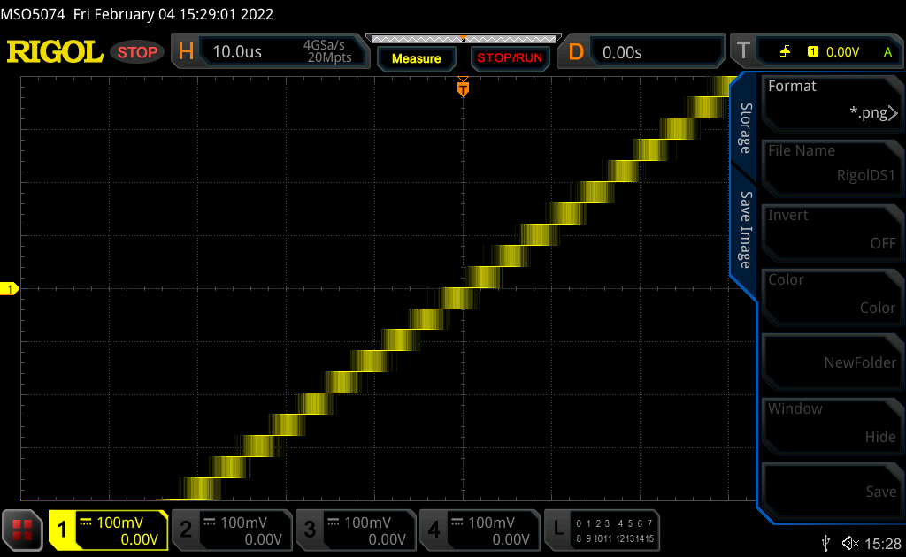
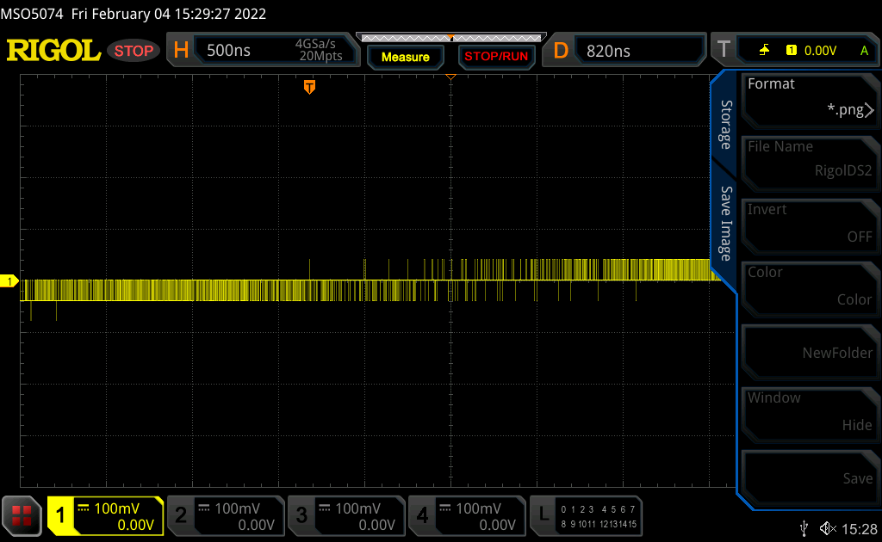
Real world weirdness

Slide 4
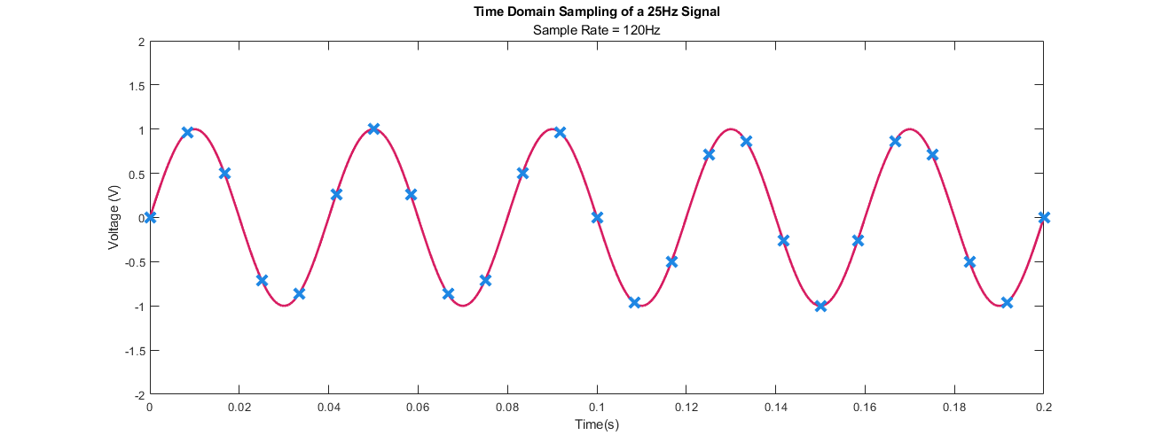
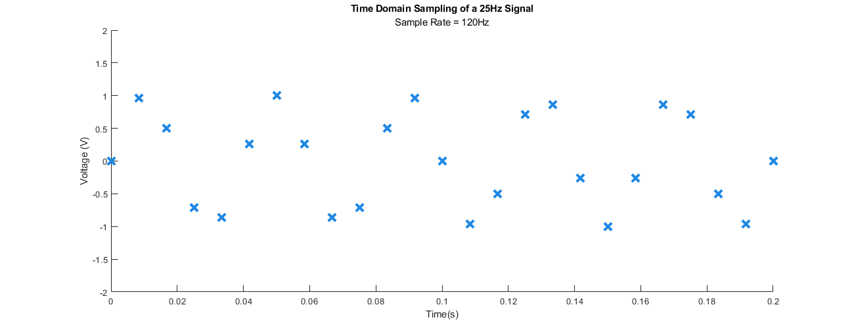
Sampling – Time and Amplitude Domain
Actual Input Signal
What the Scope
Captured
What the Scope
Captured

Slide 5
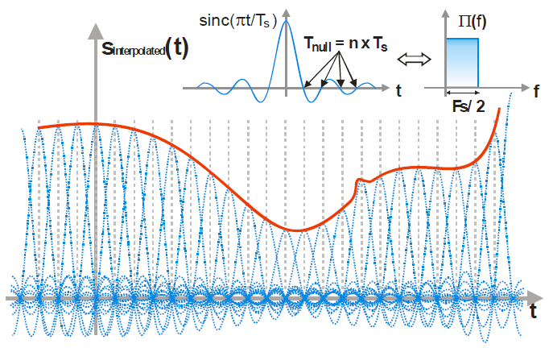
Interpolation
X
X
X
X
X
X
X
X
X
X
X
X
X
X
X
X
X
X
X
X
X
X
X
X
X

Slide 6
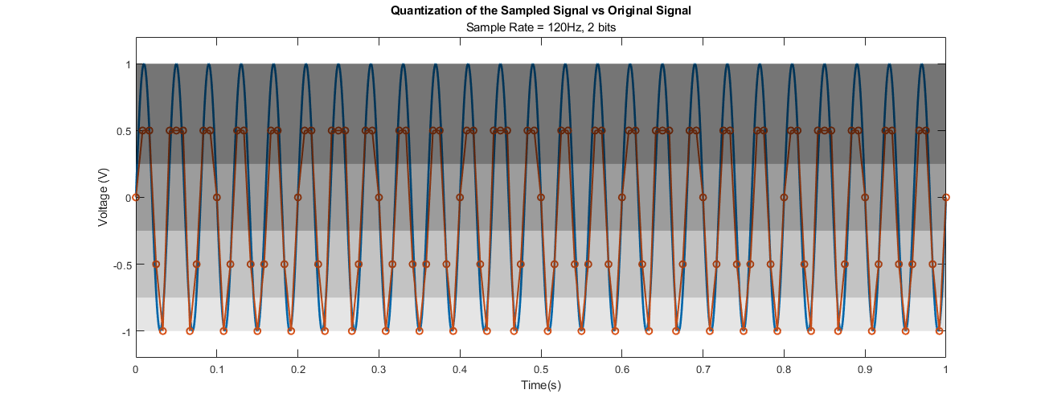
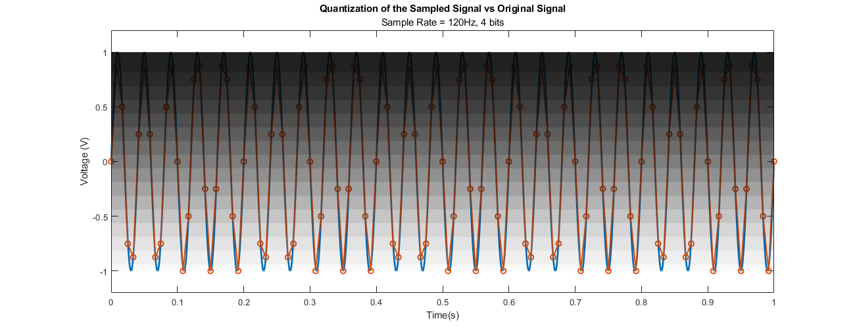
Vertical Resolution – Typically 8 bits
2 bits/
4 Levels
4 bits/
16 Levels

Slide 7
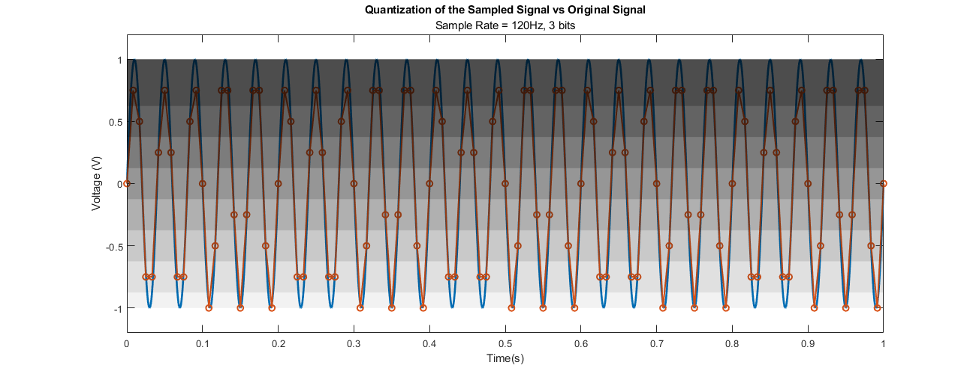
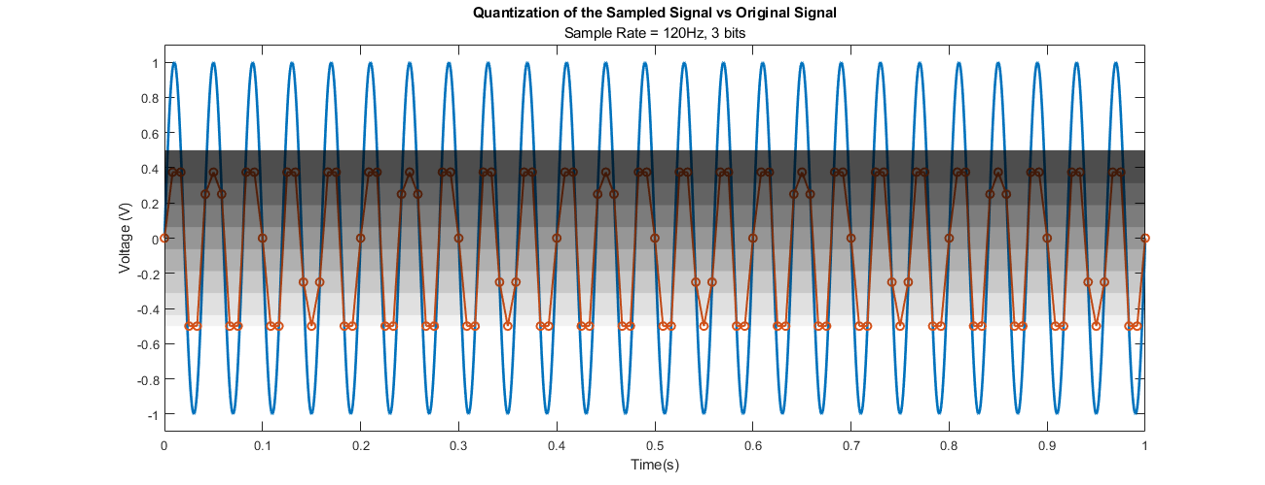
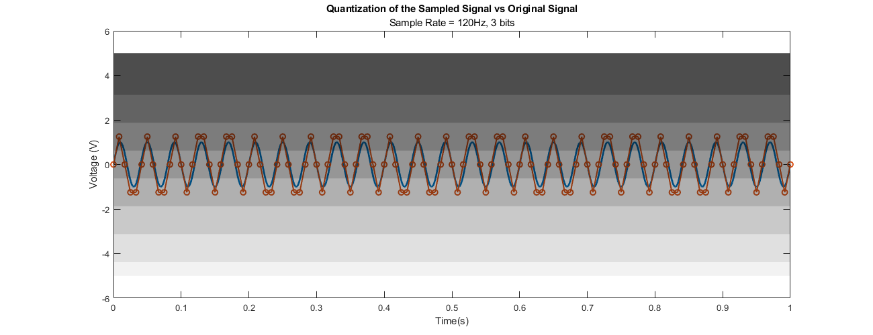
Vertical Scale Impact
8 levels, perfect range
8 levels, but missing part of waveform
3 effective levels

Slide 8
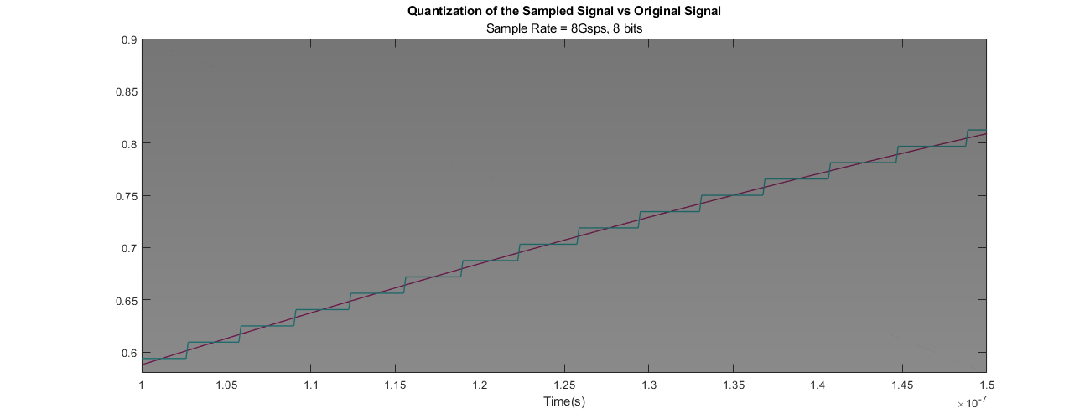
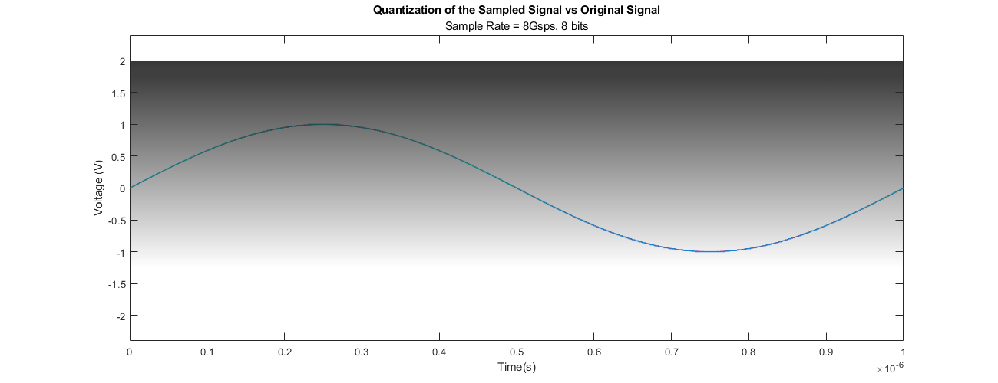
Realistic Example w/o interpolation 8Gsps, 8bits

Slide 9
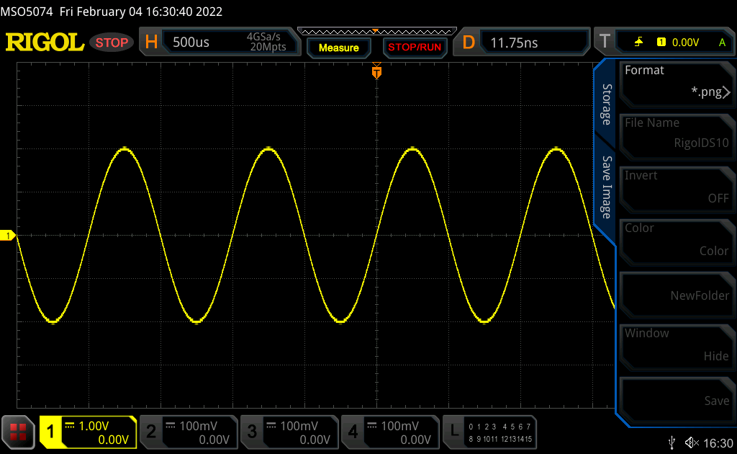
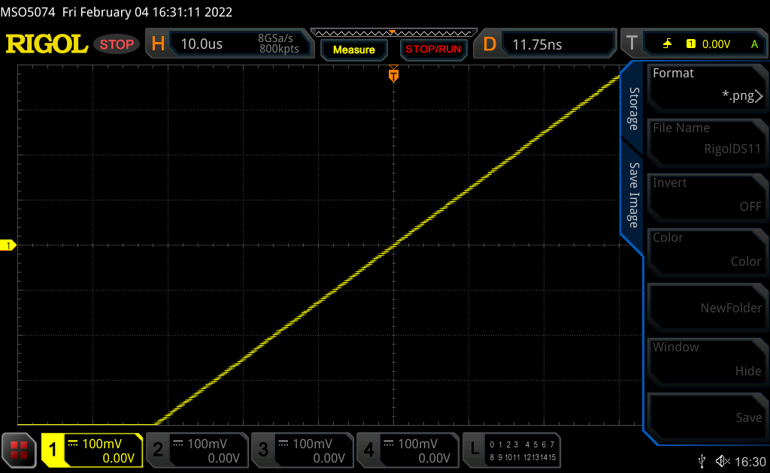
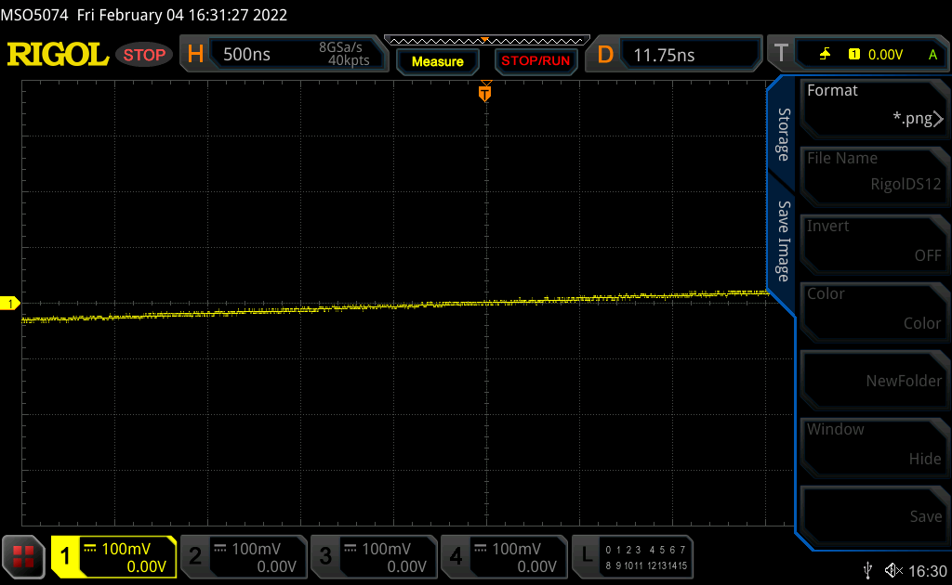
Trigger then zoom vs zoom then trigger
8 bit (256 level) resolution range is reset each time we change vertical scale

Slide 10
Triggering
Overview
Edge
Rising
Falling
Rearm/Hold-off
Single Shot
Other

Slide 11
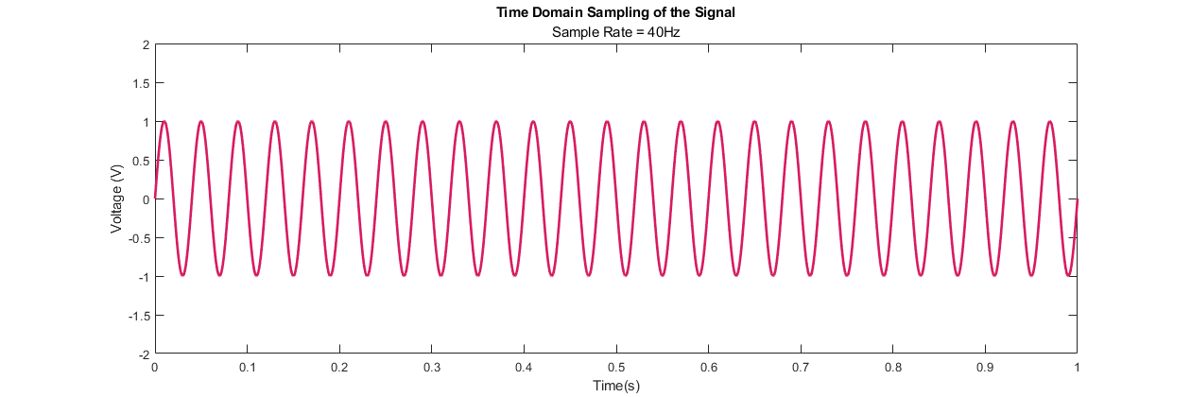
Rising Edge Trigger/Re-Arm System
------------ Display ------------
------------ Display ------------
Trigger
Trigger
----------------------- Re-arm Time ------------------------

Slide 12
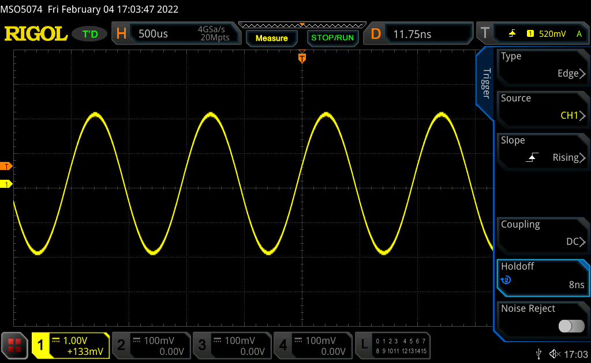
Trigger Setup

Slide 13
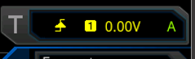

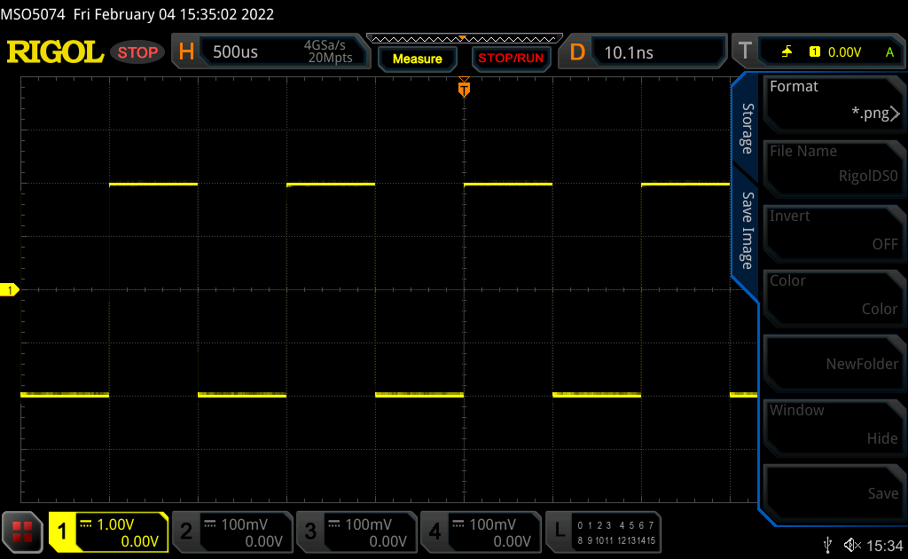
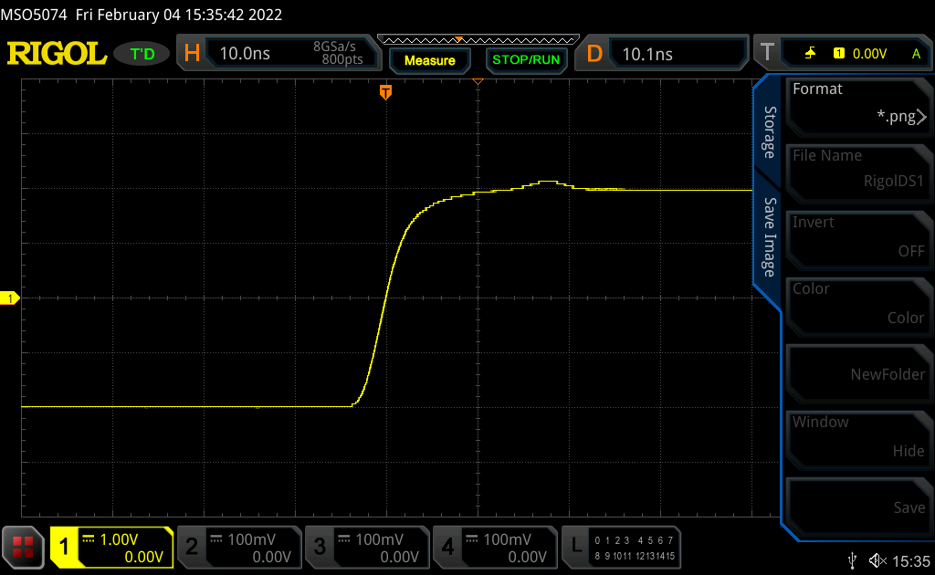
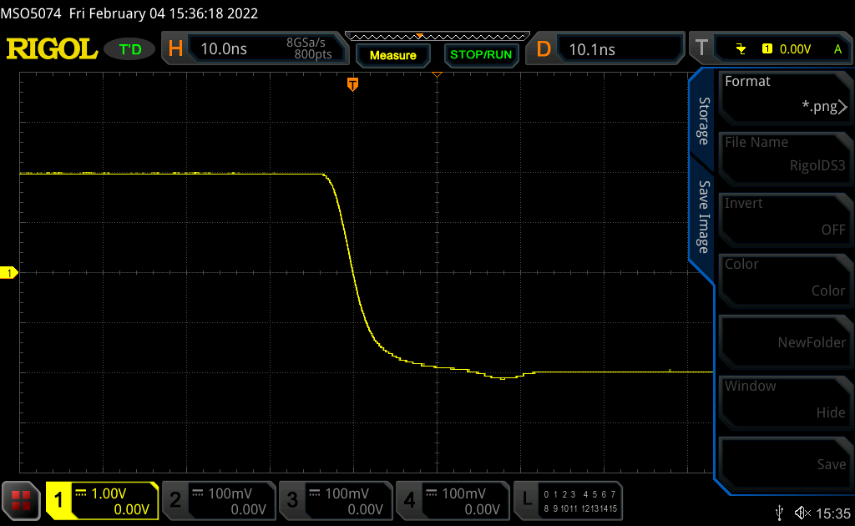
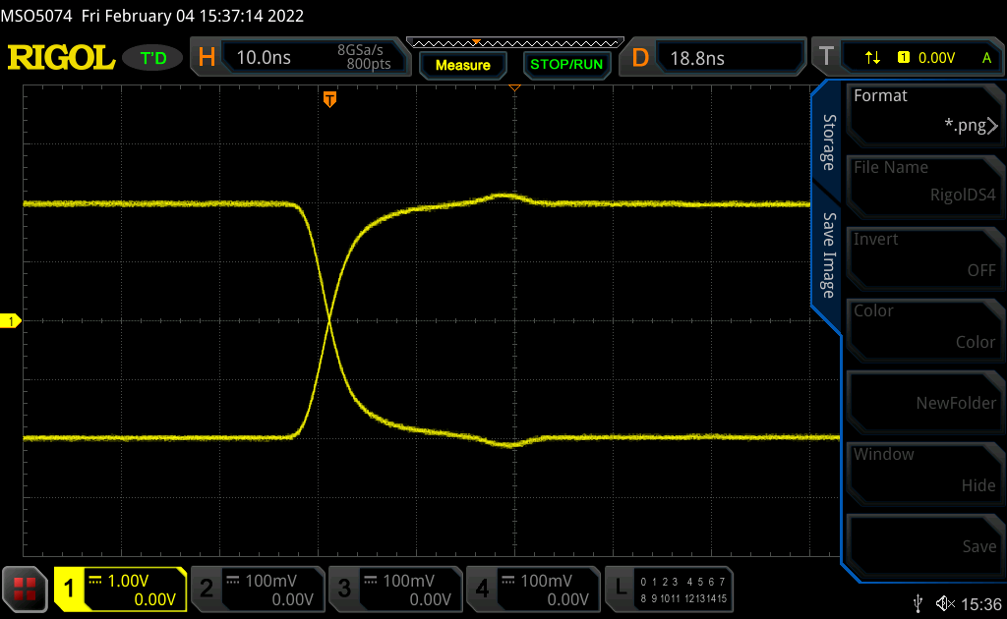


Edge Rising/Falling/Both

Slide 14
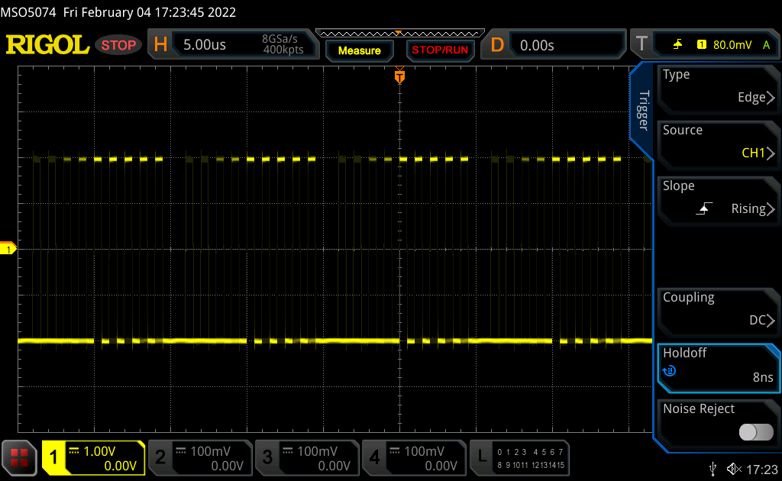
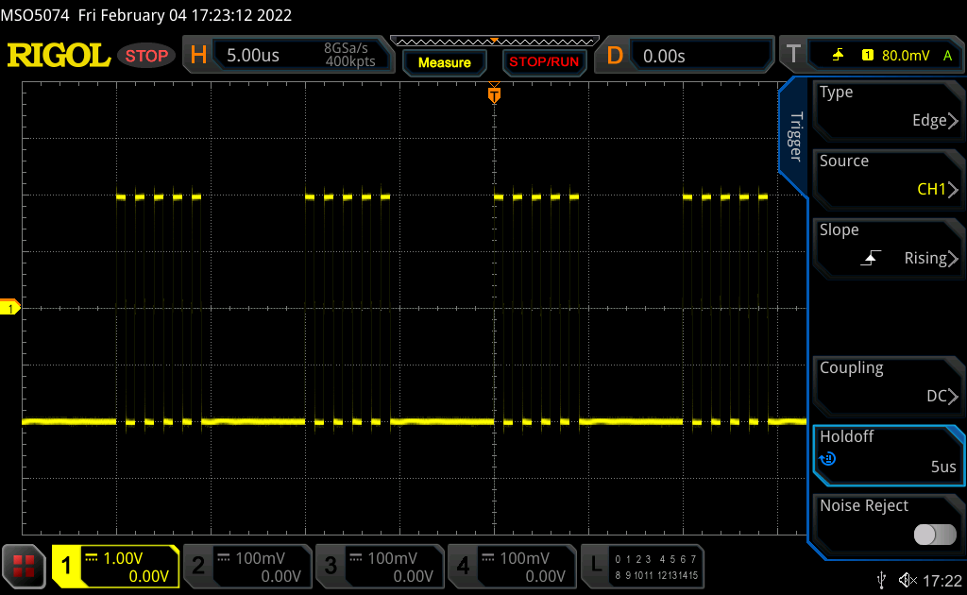
Hold Off
Ghost
5µs
T
T

Slide 15
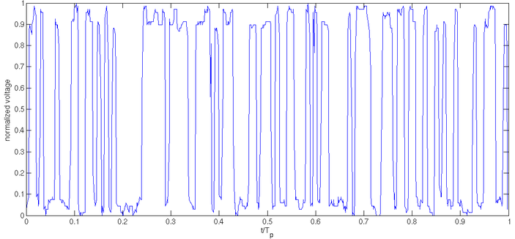
Triggering on Non-Repetitive Signals
------------ Display ------------
------------ Display ------------
Trigger
Trigger
------------------------- Re-arm Time ---------------------------

Slide 16
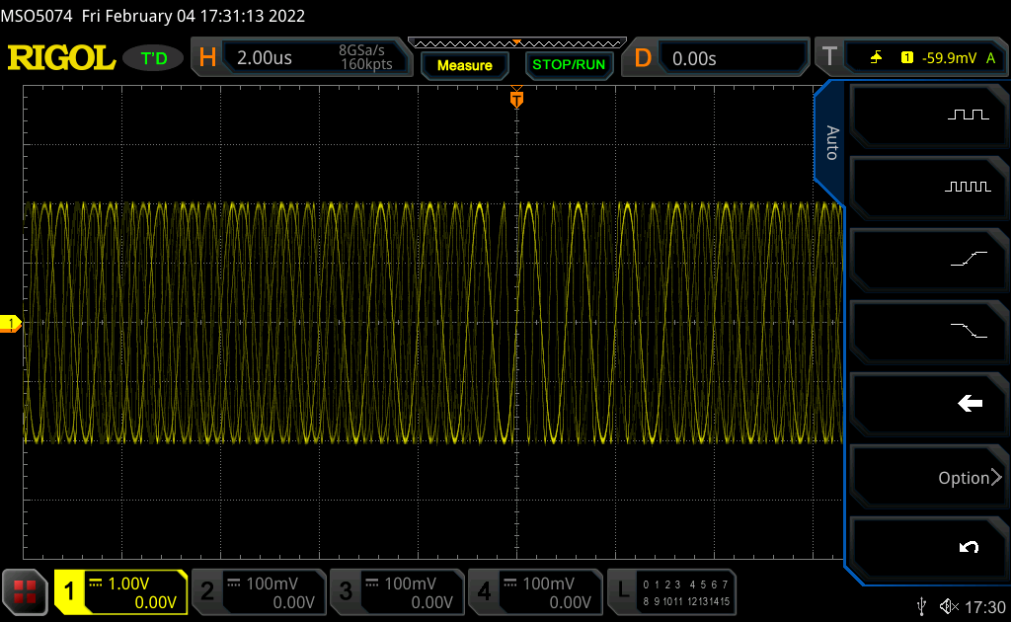
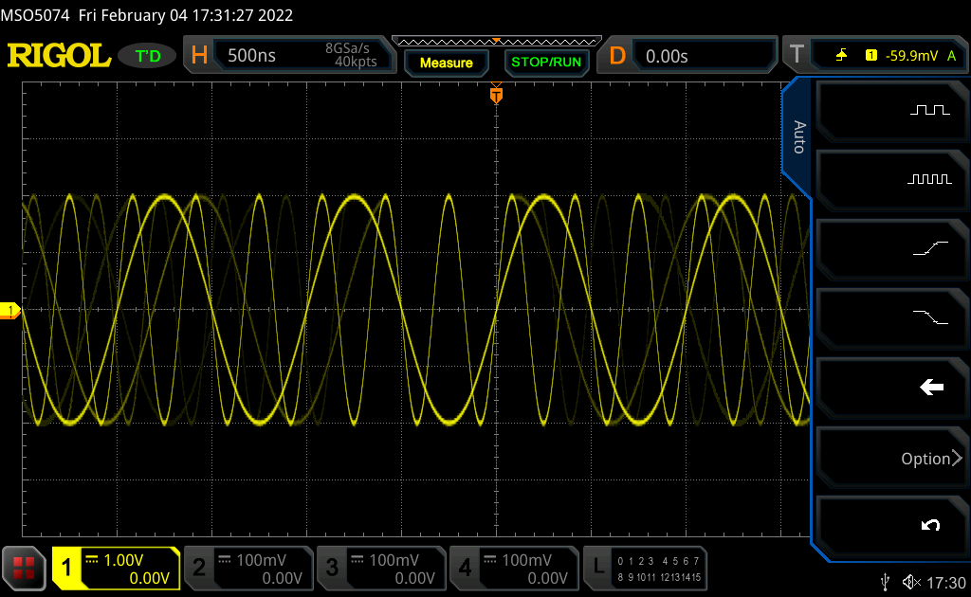
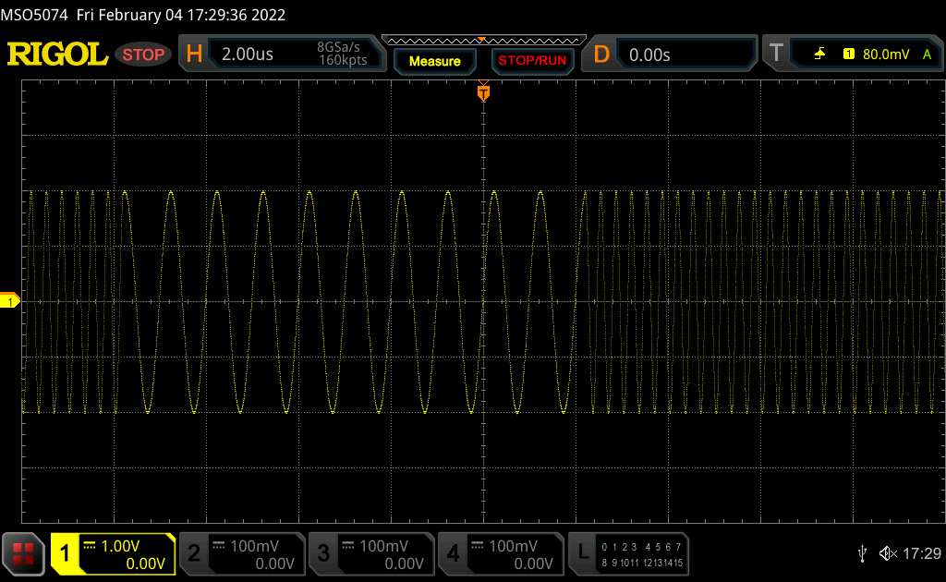
“Single/One-Shot” is your friend

Slide 17
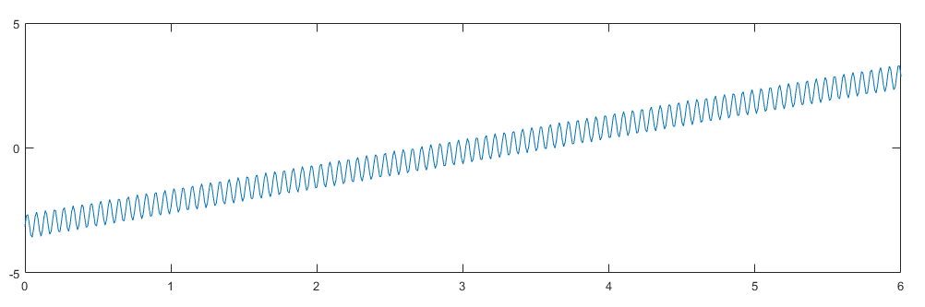
Trigger AC/DC/Bandwidth
TL;DR
Use DC coupling – 99% of the time it’s fine
If it doesn’t trigger, try AC, LFC (low freq cutoff), HFC (high freq cutoff)
AC was more useful in older scopes due to architecture differences
This could be a good use of AC triggering:
Want to watch DC on signal but trigger the whole time

Slide 18
Probing Technique
Overview
Edge
Rising
Falling
Rearm/Hold-off
Single Shot
Other

Slide 19
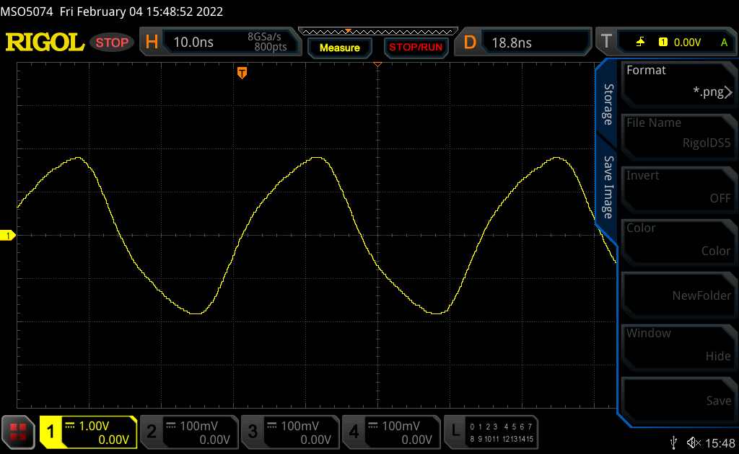
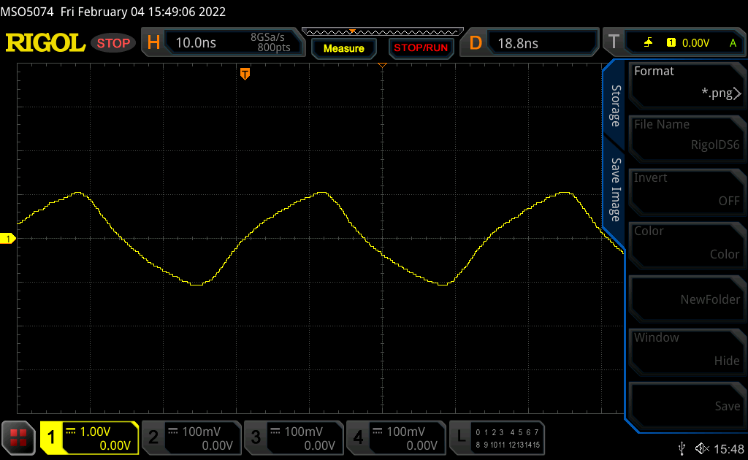

30MHz Signal Probing

Slide 20
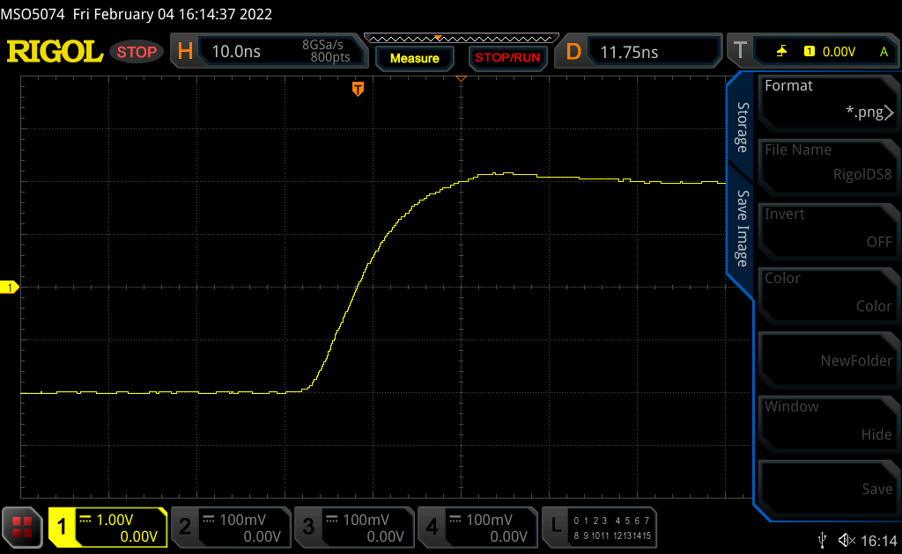

1MHz Signal Probing

Slide 21
1MHz vs 30MHz Comparison Rising edge error worse at 1MHz!
1MHz
30MHz

Slide 22
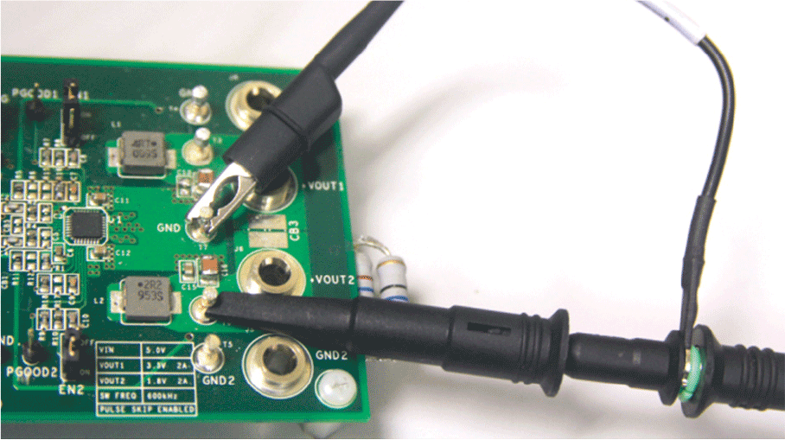
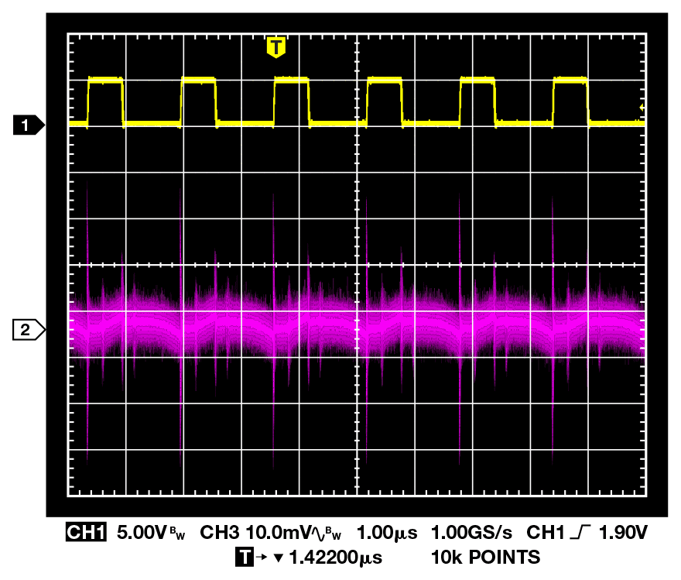
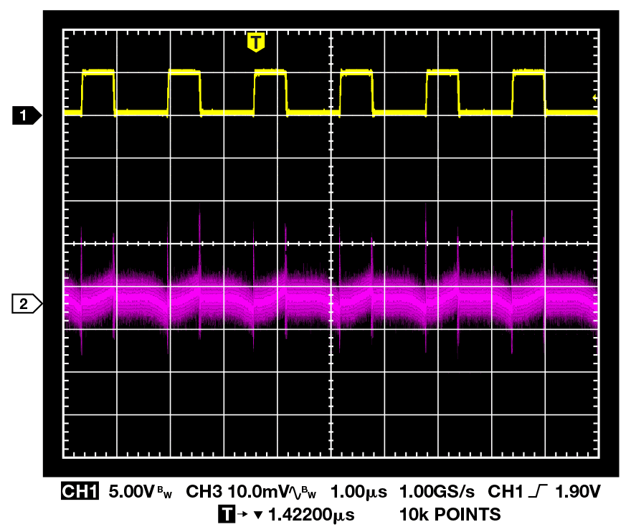
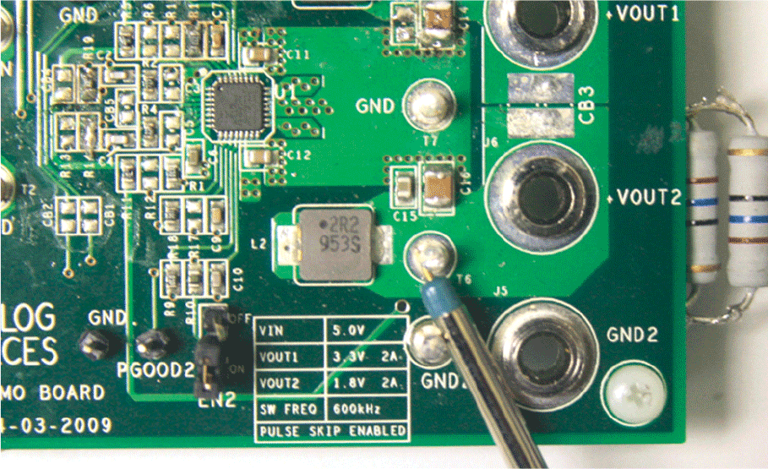
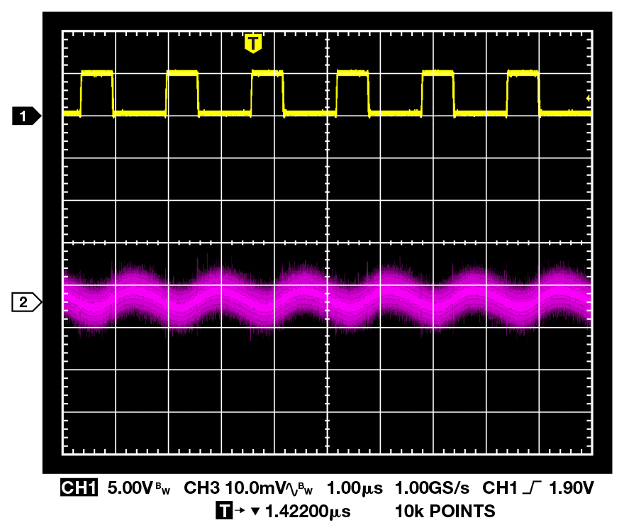
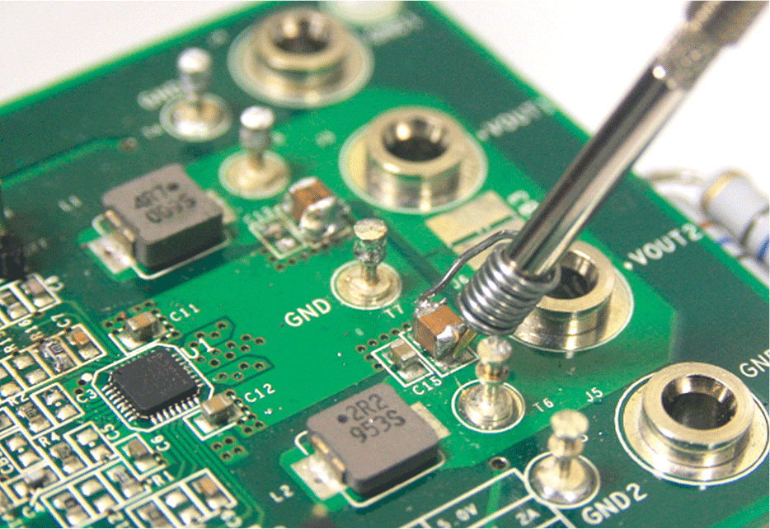
Probing Techniques

Slide 23
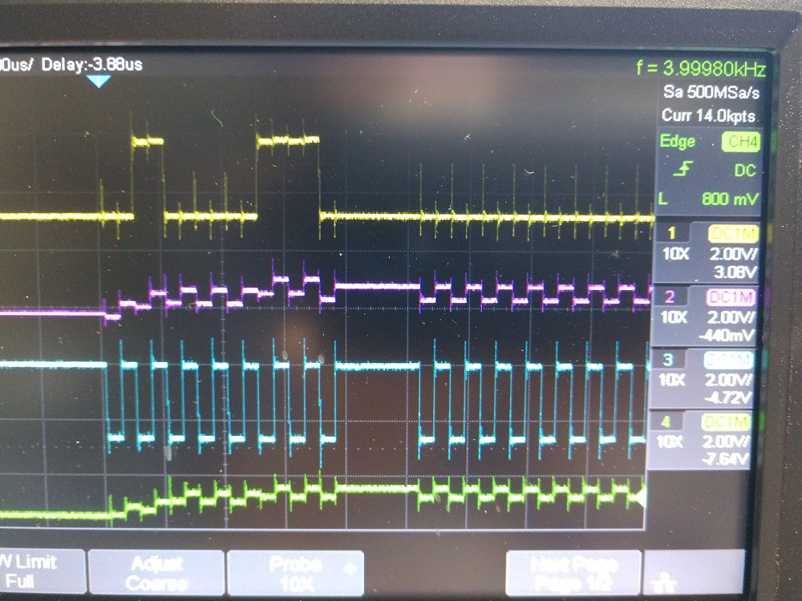
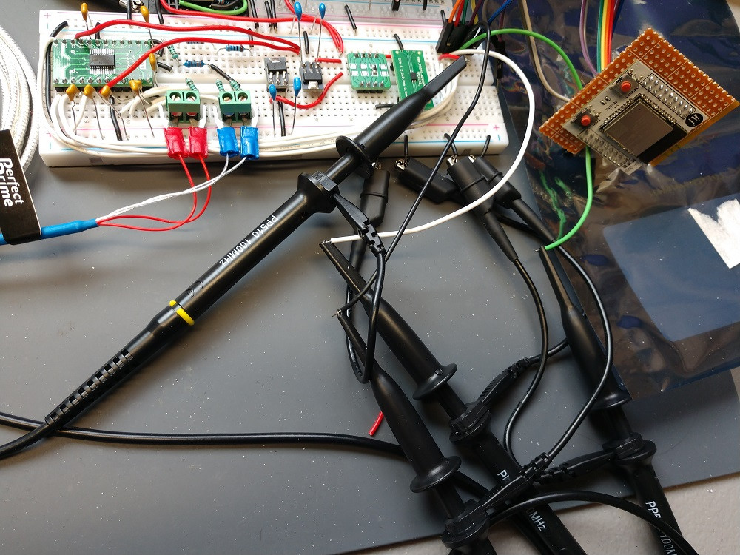
Stack Exchange Question
Is the overshoot real?

Slide 24
1x vs 10x vs 50Ω Probes
TL;DR
Use 10x probe
If measuring very low-voltage signals which are getting buried in noise – use 1x probe
If measuring something that expects a 50 Ω load – use 50Ω
Function generator
RF test equipment
RF amplifiers
Not all scopes have a 50Ω option
If measuring very low-voltage signals which are getting buried in noise – use 1x probe
10x probe setting typically has much better bandwidth

Slide 25
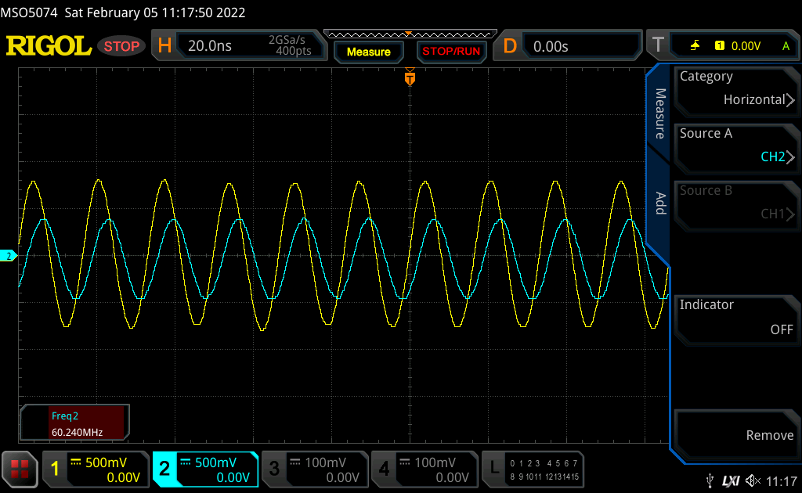
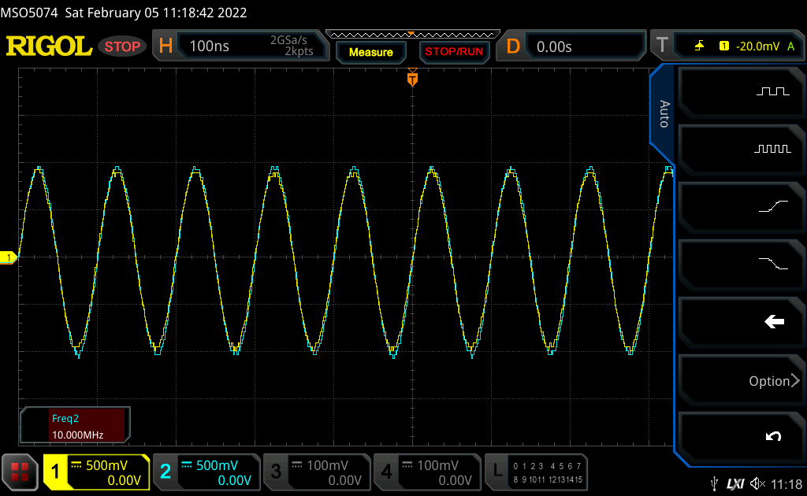
1x vs 10x Probe Bandwidth
60MHz
10MHz

Slide 26
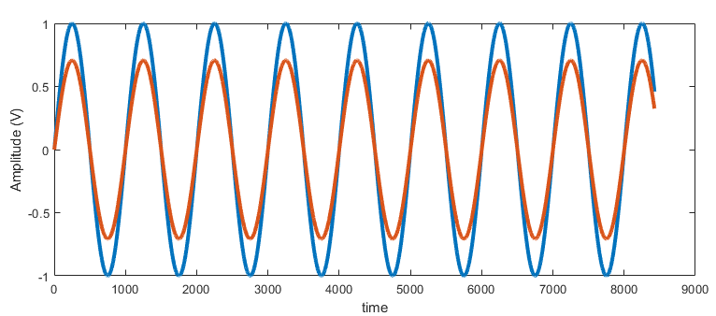
Scope Bandwidth
IEEE 1057: Scope bandwidth is where a sine wave is displayed 3dB below its actual amplitude value
A 1V sine wave would display as 0.707V
This may not actually be true for a given scope
What’s enough bandwidth?
Audio: 50kHz
General purpose analog/digital – 1MHz-50MHz?
0dB
-3dB

Slide 27
Sample Rate
Sample rate - # of samples per second
Often divided by number of active channels
What’s good enough?
At least 4x the data rate of digital signals
I2C: 1Msps
1MHz SPI: 4Msps
10MHz bus with clock: 9 x 40Msps = 360Msps

